Slide 1


The key role of the
Center for European Studies in the educational system of Yerevan State University
Dr. Ashot Aleksanya
Associate Professor
Center of European Studies

Slide 2
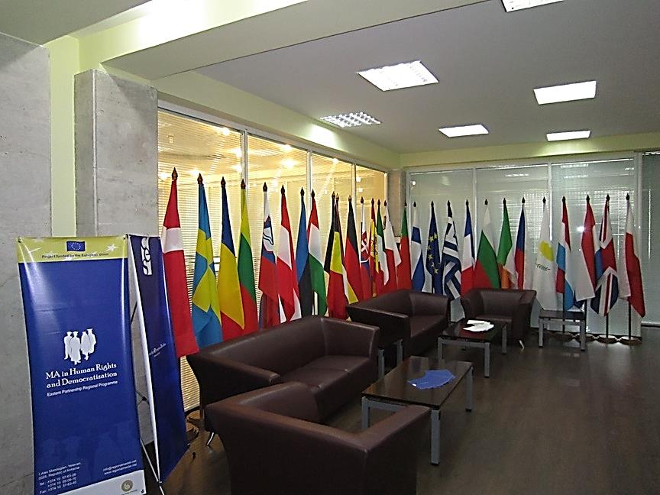

Slide 3

CES is an independent educational and research institution
CES is an independent educational and research institution, founded in July 2006 as a result of fruitful cooperation between Yerevan State University and EU Delegation to Armenia.
CES is funded by yearly grants provided by the State Science Committee of the Ministry of Education and Science RA.
Being a unique educational and research institute specializing in EU studies, the Centre aims to promote EU-Armenia cooperation and the process of Armenia’s European Integration through implementation of versatile and interdisciplinary researches as well as educational programmes corresponding to European standards.
CES provides graduate education in the field of European Studies, carries out specialized and multidisciplinary researches and provides consulting to NGOs, public and private organizations dealing with EU affairs.
To fulfill the aforesaid functions the Centre has recruited qualified professionals majoring in EU studies, hosts guest lectures, researchers, fellows, experts and students from partner universities.

Slide 4
CES VISION
The Vision of CES is to see Armenia in Europe
CES carries out its activities in the following fields:
Education
Interdisciplinary and specialized researches
Expert analysis
EU information Center

Slide 5
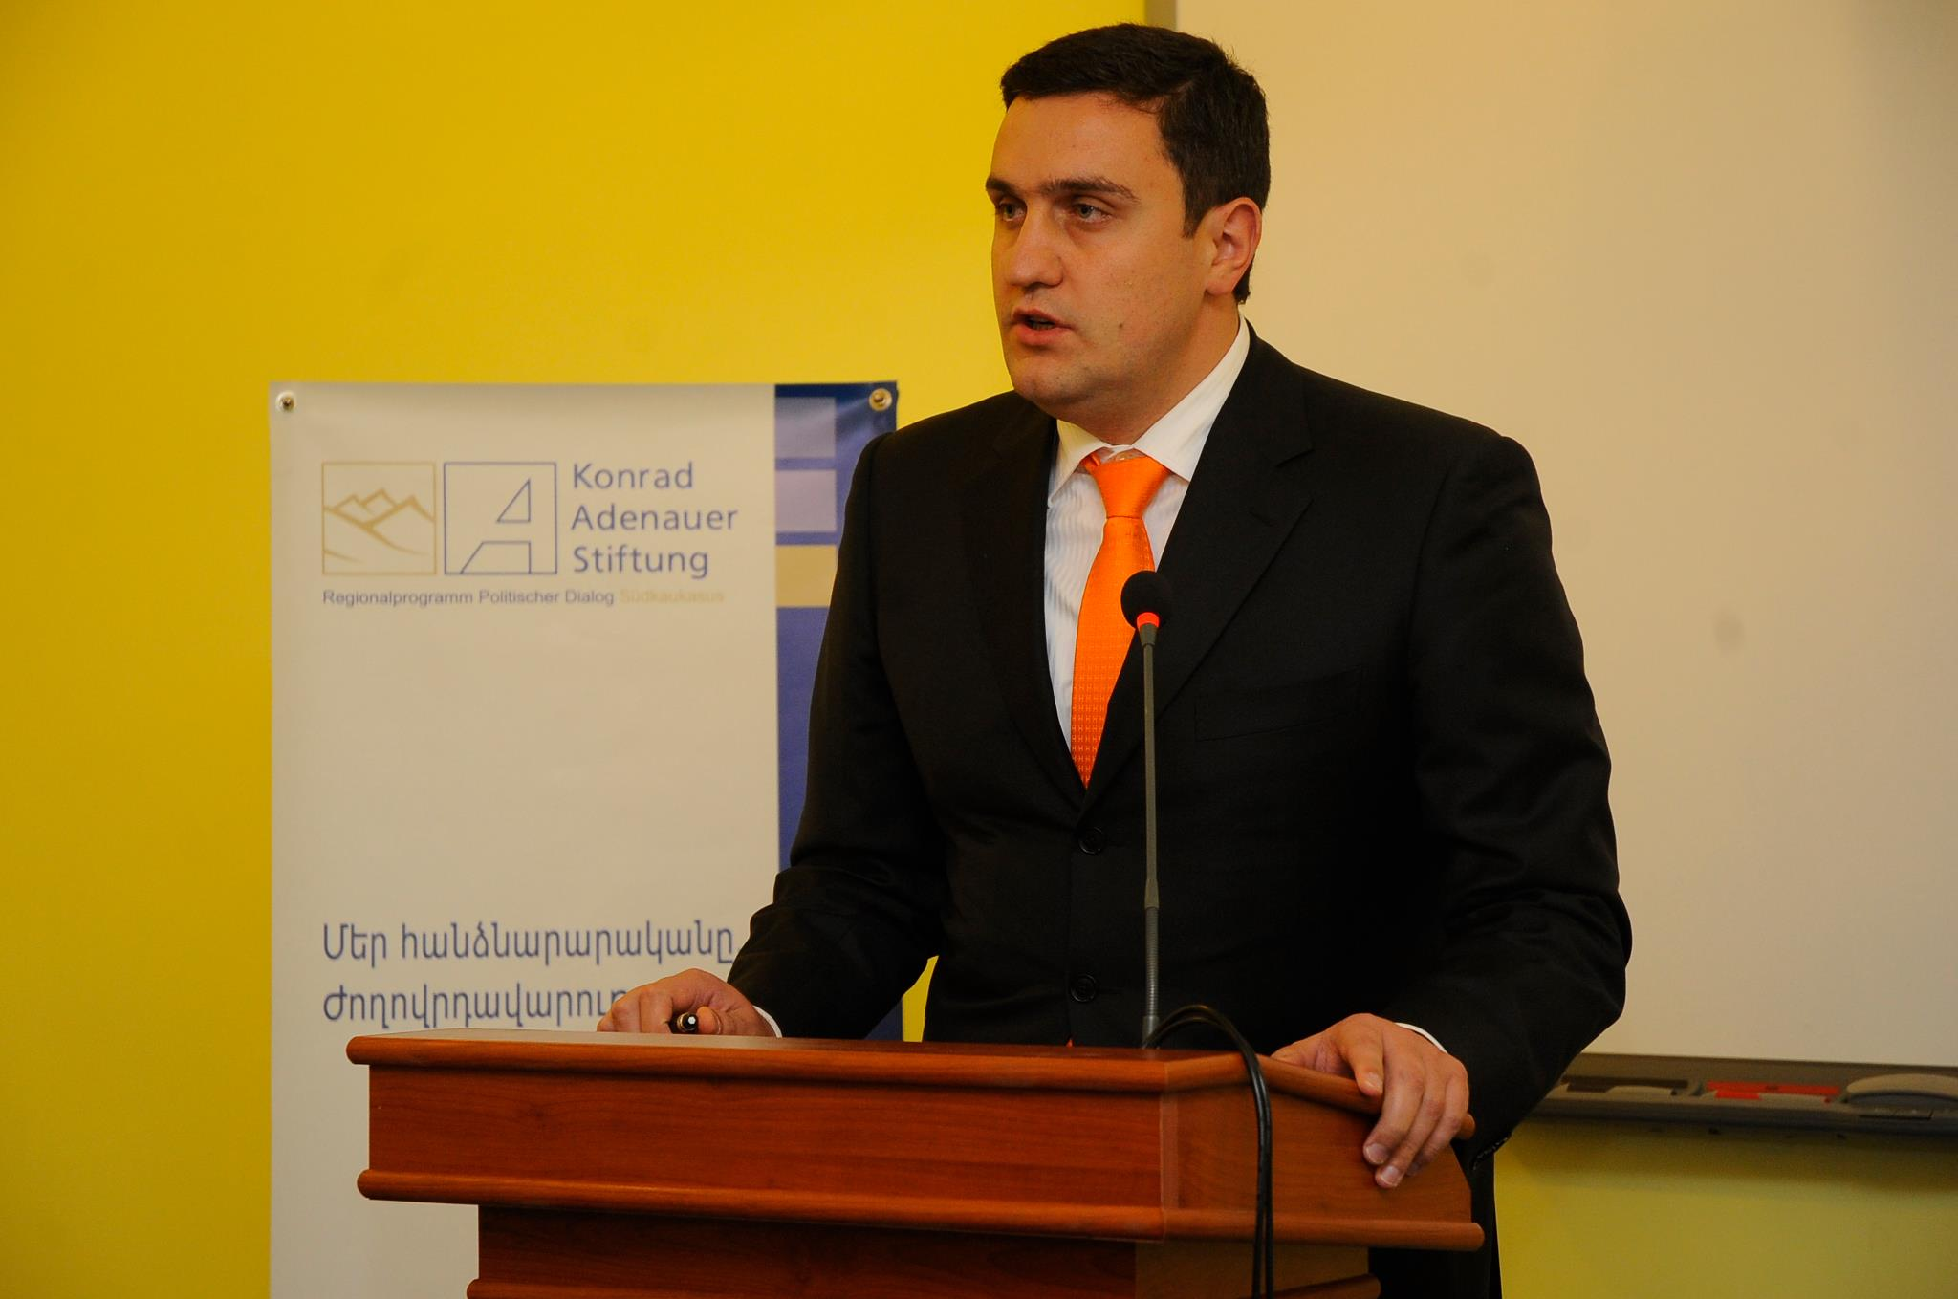
CES Staff
Administrative staff
International Experts/Fellows
Senior Experts, Experts / Lecturers
Dr. Artur Ghazinyan
Director of the CES
https://www.facebook.com/aghazinyan
https://www.facebook.com/pages/Artur-Ghazinyan/473981732665357

Slide 6
Area of scientific principles and the analysis of European studies
European Studies as a field of interdisciplinary study and research are using scientific, sociology and historic methods, collecting/analysing data from different sources, scientific method, the systems theory, changes, balances and regulation, risks and impact.
The processes of European Integration and EU enlargement have essentially increased the importance of European Studies all over the world, as well as in Armenia. European Integration has been proclaimed as one of the main priorities of Armenia’s foreign policy and within its framework, various economic, social, political, and legal projects and reforms are being implemented.

Slide 7
Partners of the Center
Delegation of the European Union to the Republic of Armenia
RA Government
The EU Advisory Group to the Republic of Armenia
UNDP United Nations House
OSCE Office in Yerevan
AEPLAC
Council of Europe
British Council
GIZ
USAID Armenia
TEMPUS
European Movement
International Center for Human Development

Slide 8
International Cooperation
European University Institute
University of Siena (Università degli Studi di Siena)
LUISS GUIDO CARLI University
The London School of Economics and Political Science
University of Bath
Vrije Universiteit Brussel
Philipps-Universität Marburg
Gottfried Wilhelm Leibniz Universität Hannover
The University of Sydney
Taras Shevchenko National University of Kyiv
Belarusian State University
Universitatea De Studii Politice Si Economice Europene

Slide 9


European Studies KU Leuven
Institute for International and European Policy, Faculty of Social Sciences, KU LEUVEN, Belgium
http://www.kuleuven.be

Slide 10

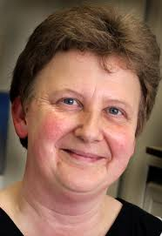
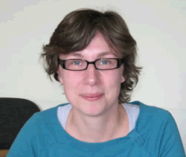

.
Prof. Dr. Katlijn Malfliet Dr. Ria Laenen
Prof. Dr. Katlijn Malfliet – Dean of Faculty of Social Sciences
Dr. Ria Laenen - Co-ordinator, Institute for International and European Policy Research Group on Russia and Eurasia

Slide 11
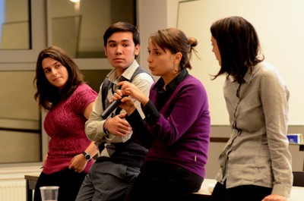

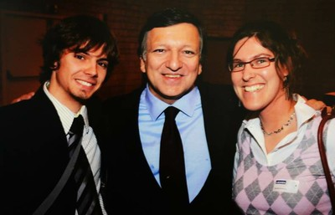
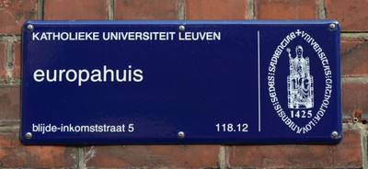
JEAN MONNET CENTRE OF EXCELLENCE
Master of European Studies: Transnational and Global Perspectives (MAES) (60 ECTS) http://ghum.kuleuven.be/ces/
In the interdisciplinary Master in European Studies: Transnational and Global Perspectives we educate a global elite that understands Europe as a region of historical diversities as well as intense interactions across national boundaries and exchanges with the outside world.

Slide 12

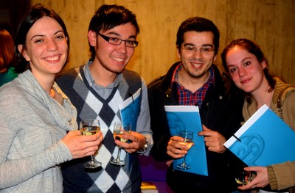
European Studies KU Leuven
The four interdisciplinary modules focus on: (1) Transnational Perspectives on European History, Diversity and Culture; (2) EU External Relations; (3) Globalising Europe; (4) Europe – Asia: Interactions and Comparisons.
The Master of European Studies is a truly international programme, taught in English. MAES takes part in the Erasmus Mundus External Cooperation Windows. Currently, MAES has students from a large variety of academic backgrounds, originating from more than 30 nationalities from all around the world. The programme is part of the Jean Monnet Centre of Excellence on 'The European Union, Foreign Policy and Global Governance'.
The programme Master of European Studies: Transnational and Global Perspectives, is offered in the excellent academic environment of the K.U.Leuven. The K.U.Leuven has been highly ranked in several university rankings. In the Times Higher Education Ranking, the Arts and Humanties at the K.U.Leuven are ranked 3rd on the European continent and on a 41st place worldwide.

Slide 13
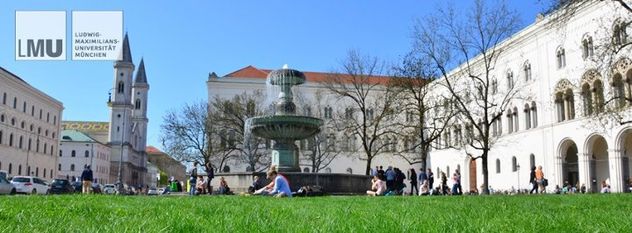
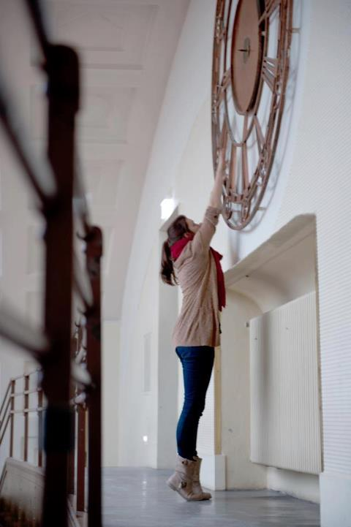


Ludwig-Maximilians-University Munich
Faculty of Social Sciences
Dean Prof. Dr. Hans-Bernd Brosius brosius@ifkw.lmu.de
dekanat15@lmu.de
Prof. Dr. Petra Stykow; petra.stykow@lmu.de
Institute for Political Science, Comparative Politics (Focus: CIS, Eastern and Central Europe)
https://www.facebook.com/lmu.muenchen

Slide 14
MA Programmes
For the achievement of its goals, the Centre for European Studies has prioritized the development of the educational programmes based on European values. For that purpose CES is constantly engaged in introducing the EU educational tools into the provided MA programmes.
The CES MA programmes are structured in a way to provide the students with profound knowledge and complete understanding of the EU relevant structures and policies. Upon completion of the studies the students will have attained all the necessary theoretical background and practical skills for immediate employment.
MA European Studies
MA Human Rights and Democratization

Slide 15
MA European Studies
Since 2008 CES implements interdisciplinary “European Studies” Master Programme, which was initiated with the support of EU Delegation to Armenia.
During the two years of the master’s programme students of the European studies are provided with a comprehensive set of courses dealing with the political, socioeconomic and legal environment.
The programme’s primary focus is to provide students with analytical reasoning, and problem solving skills through the study of European institutions, policies and procedures, sustainable economic development and security systems. The Master of European studies aims to provide students with the knowledge, skills and competences needed for prospective employment in education provision, public service, research centers as well as international organizations. The academic programme has multi-disciplinary approach with strong emphasis placed upon providing students with a comprehensive understanding of European politics and integration.

Slide 16
GRADUATION REQUIREMENTS
To graduate with the Master of European Studies, students must complete 120 credit hours of coursework, including the Master’s Essay comprising 12 credits, and the GPA (Grade Point Average) should be not less than 12,00.
GRADING
The faculty performs grading based on the grading criteria developed by the university. The performance indicators, which are the comprising components of the cumulative grade, are as follows: attendance, assignments, formative and summative exams.
TUITION FEE
Applicants should consider the financing of their education at CES from the time of their admission to the graduation from the academic programme. Students in degree programmes sign a contract with Yerevan State University upon enrollment that sets tuition for the mode and period of education, tuition fee installment schedule, etc. For detailed information see the contract template.
The tuition fee for students enrolled in European Studies MA Programme is: 750,000 AMD per year.

Slide 17
MA CURRICULA AND COURSES
A full time study in MA programme considers student enrolment for two academic years and workload per year is equivalent to at least 60 ECTS credits.
The curriculum consists of two main sections – academic learning and research. Out of 120 credits 48 is accumulated from research section. The Programme has both compulsory and elective courses equally divided into legal, political, governance and economic modules. The Programme has also incorporated new Jean Monnet Module named “European Integration and the South Caucasus” which is funded by EU grant.

Slide 18
The MA main courses are as follows:
Theory and History of European integration (6 credits)
Fundamentals of the European Union Law (6 credits)
Introduction to International Economy (6 credits)
Theory of Law (3 credits)
Introduction to European Integration: Cultural aspects (3 credits)
EU Institutions and Procedures (3 credits)
European civil society (3 credits)
Legal Regulation of European Single Market (3 credits)
Advanced translation courses /English/ (3 credits)
Advanced translation courses /French/ (3 credits)
EU security and Defense Policy (3 credits)
Introduction to “Aquis Communitaires” (3 credits)
World economy: EU-Armenia cooperation (3 credits)
English for Specific Purposes (3 credits)
Fundamental Human Rights, EU Citizenship and status of non-member states’ citizens (3 credits)
Principles of Public Administration in European States (3 credits)
International Law (3 credits)
European Neighborhood Policy (3 credits)
Legal dimension of EU foreign Policy (3 credits)
Precedence of the European Union Court (ECJ) (3 credits)
European Economic Integration and EU economics (3 credits)
The development of the European legal customs from ancient times to the 21st century (3 credits)

Slide 19
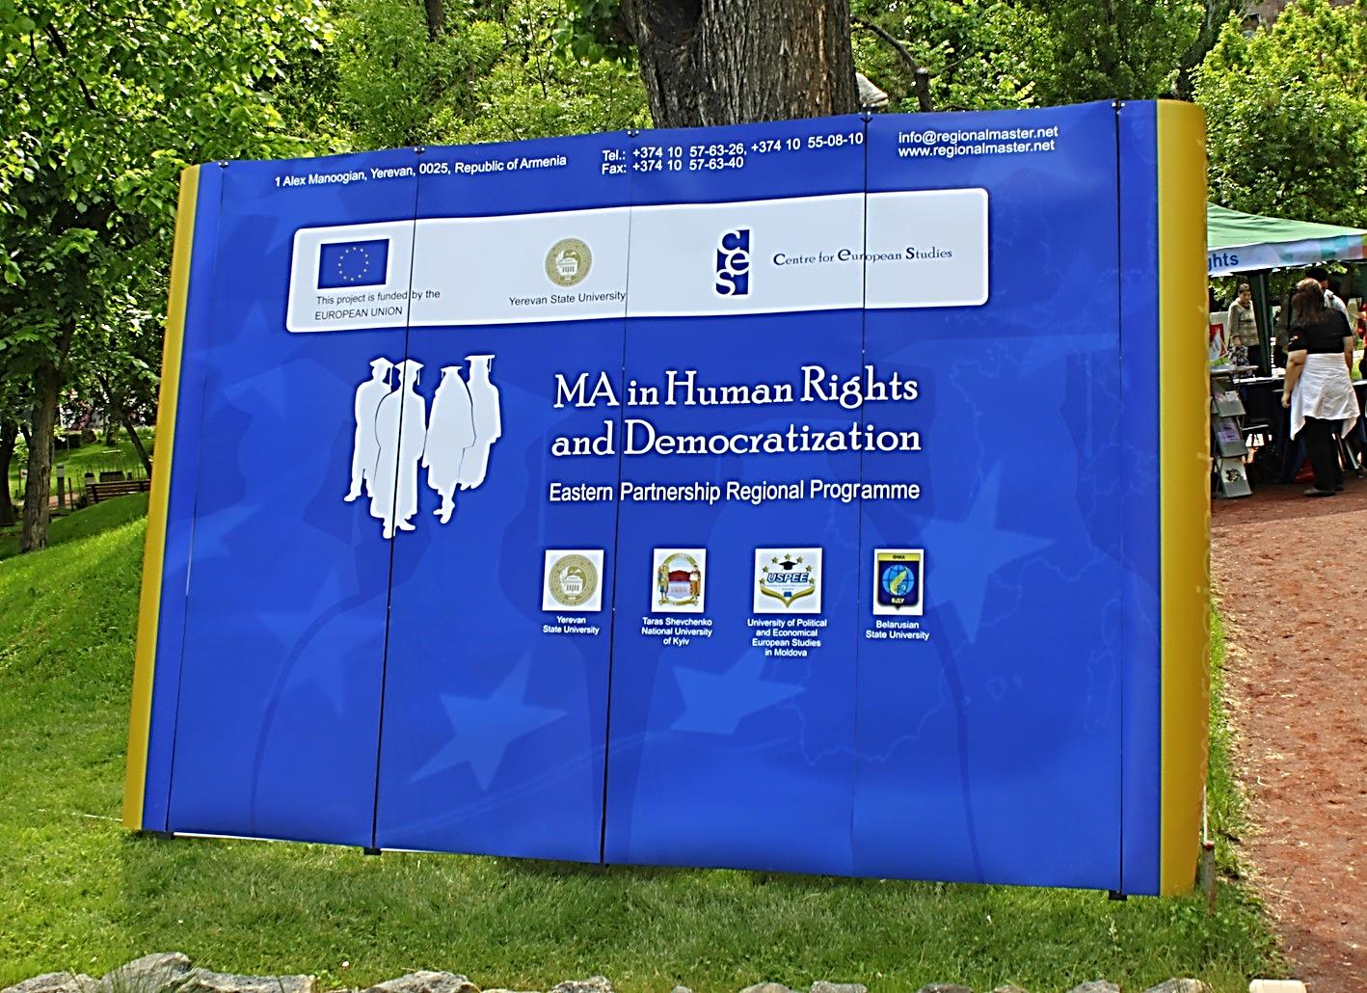
Regional Interdisciplinary Master's Programme in Human Rights and Democratization

Slide 20

Regional Interdisciplinary MA in Human Rights and Democratization
This innovative new degree provides:
A unique interdisciplinary master’s level education in human rights and democratization in the entire Post-Soviet area.
European quality education in human rights and democratization.
Career opportunities in international, governmental and non-governmental organizations, as well as in the academic sphere.
Qualified teaching staff, including academic experts and highly qualified specialists with professional experience in international organizations such as the UN, Council of Europe and OSCE.
A joint degree granted by four universities and Study visit to European institutions.
Student mobility between the 4 partner universities.
A multicultural learning environment

Slide 21
Regional Interdisciplinary MA in Human Rights and Democratization
The Master’s Programme in Human Rights and Democratization is the first interdisciplinary Master’s Programme in Human Rights and Democratization in Eastern Partnership region. The programme is specifically designed for all those who are interested in gaining comprehensive education and expertise in human rights and democratization in the region.
Upon completion of our Master’s Programme students will know how:
to address human rights and democratization related issues,
to apply gained knowledge and skills to a variety of real life problems,
to facilitate reforms directed to improve the effective functionality of democratic institutions and the environment for human rights.

Slide 22
MA in Human Rights and Democratization aims to:
Provide master’s level education through the application of an interdisciplinary approach to the fields of human rights and democratization,
Develop students into qualified professionals that are equipped with a high level of expertise in human rights and democratization in the Eastern Partnership Region,
Improve the academic environment and scholarship of interdisciplinary research and teaching in the filed of human rights and democratization at the regional level with the application of best practices in Europe,
Creation of network of Human Rights NGOs in Eastern Partnership Region.

Slide 23
Description
This Programme will be conducted in English and Russian, the two most commonly used languages in the region.
The main feature of this programme is student mobility. The first and second semesters take place in Armenia, at Yerevan State University. The third semester is run by one of the three partner universities. Students have the opportunity to specialize in one of three modules: Political, Legal and Interdisciplinary.
The Political Science Module by Belarusian State University;
The Legal Module by Taras Shevchenko National University of Kyiv;
The Interdisciplinary Module by University of European Political and Economic Studies.
The fourth semester - completion of a thesis and internship. To facilitate students’ acquisition of practical knowledge and experience the Programme cooperates with leading Human Rights NGOs in the Eastern Partnership Region.

Slide 24
Qualifications
Master of Arts in Human Rights and Democratization
Successful students of the Regional Master’s Programme in Human Rights and democratization will receive a Master of Arts degree in European Studies, specialization –Human rights and Democratization. The degree will be accompanied by a diploma supplement, which will list all the courses the student has attended and the grades received.
ECTS
The MA programme in Human rights and Democratization is a two-year Master’s Programme that is divided into four semesters. The Master’s Programme is guided by the Bologna Standards, including ECTS student assessment. It is made up of 120 credits (27 and 24 credits for first and second terms, 21 credits for third term and 48 credits for fourth).

Slide 25
Programme Structure
Term 1 September-December 2011
Acquisition of Theoretical Base |  | Yerevan State University Home university
Thematic Sections 1-4 | 27 credits
Term 2 February-May 2012
Deepening of Theoretical Knowledge |  | Yerevan State University Home university
Thematic Sections 5-7 | 24 credits
Term 3 (Mobility Term) September-December 2012
Field of Specialisation
Legal Module | 21 credits | Taras Shevchenko National University of Kyiv Host University
Political Science Module | 21 credits | Belarusian State University Host University
Interdisciplinary Module | 21 credits | University of European Political and Economic Studies (USPEE) Host University
Term 4 February-May 2013
Practical Application |  | Choice Based
Master Thesis | 24 credits
Internship | 6 credits
Scientific Research | 18 credits

Slide 26
MA in Human Rights and Democratization
Curriculum for Interdisciplinary MA in Human Rights and Democratization
2011 – 2013
Semester Courses

Slide 27
LIST OF COURSES 2011-2013
Term 1 |  | Yerevan State University
Course | Lecturer
Academic writing | Rubina Gasparyan
Theory of Democracy | Dr. Alexander Markarov
Theoretical Bases of Human Rights | Vahan Bournazian, JD.
The United Nations Human Rights System | Dr. Armen Baibourtian/ Talin Hitik
Mass media and democracy | Aram Abrahamyan
European Judicial Protection of Human Rights | Siranush Sahakyan
Criminal and Legal Protection of Human Rights | Dr Anna Margaryan
National Minorities Rights Protection | Dr. Vigen Kocharyan Associate Professor
Protection of Human Rights during armed conflicts | Dr. Karen Gevorgyan Associate Professor
EU and Democracy | Dr. Gunter Walzenbach University of the West of England, UK (visiting lecturer)

Slide 28
LIST OF COURSES 2011-2013
Term 2
Course | Lecturer | Yerevan State University
Transitology | Dr. Alexander Markarov
Electoral Rights | Kåre Vollan Quality Ac, Oslo (visiting lecturer)
Peace, Security and Democratic Governance | Dr. Armen Baibourtian
Human Rights and Democratization in Eastern Partnership Programme | Richard Giragosian
Local Self-Governance, Public Participation and Local Democracy in Transitional Countries | Dr. Arthur Drampian
Conflict Resolution through Democratization | Lusine Galajyan
International Human Rights | Dr Anja Mihr Utrecht University,NL (visiting lecturer)

Slide 29
LIST OF COURSES 2011-2013
Term 3 (Mobility term) |  | Belarusian State University Host University
Course | Lecturer
International Security, Human Rights and Targeted Sanctions of International Organizations | Dr. hab. Anatoli A. Rozanov
Theory of Political System | Dr. Nina A. Antanovich Associate Professor
The EU and CIS Transformation: Political and Institutional Aspects | Dr. Alesya A. Sadovskaya Associate Professor
Democracy and Democratization in Contemporary Europe | Dr. Alexander Vashkevich
International Protection of Children Rights | Dr. Oleg M. Strovoitov Associate Professor

Slide 30
LIST OF COURSES 2011-2013
Term 3 (Mobility term) |  | Taras Shevchenko National University of Kyiv Host University
Course | Lecturer
Role of the European Court in Human Rights in Enforcing and Safeguarding Human Rights in Europe | Dr. Borys Malyshev
Civil Rights and Democracy in the Information Age | Dr. Pavlo Pushkar
Civil Remedies of Human Rights | Dr. Iurii Nosik
Human Rights in Criminal Proceedings | Dr. Olesia Otradnova
Administrative Justice as the Instrument of Human Rights Protection | Dr. Maksym Kutsevych
Human Rights and the Environment | Dr. Yevgen Gerasymenko
Asylum and Legal Protection of Refugees | Dr. Yevgen Gerasymenko
Practical Skills | Taras Tretyak,

Slide 31
LIST OF COURSES 2011-2013
Term 3 (Mobility term) |  | University of Political and Economic European Studies
Course | Lecturer
Guarantee of Human Rights in Detention Institutions | Dr. Victor Zaharia Associate Professor
Human Rights in environmental protection | Dr. Rodica Iordanov Associate Professor
Democratization through Europeanization: EU Democracy Promotion in the Eastern Neighborhood | Dr. Bănzaru Lucia
International Civic Assistance and Collaboration in the Process of Democratization | Dr. Iulian Fruntașu
Multiculturalism and Intercultural Communication within the EU | Prof. Valentina Teosa
Protection of Human Rights in the Enforcement of Tax Liability | Dr. Cristina Ejova
Practical Skills | Dr. Vlad Vlaicu Associate Professor

Slide 32
MA in Human Rights and Democratization
Curriculum for Interdisciplinary MA in Human Rights and Democratization
2012 – 2014
Semester Courses

Slide 33
LIST OF COURSES 2012-2014
Term 1 and 2 | Yerevan State University
Course
Theoretical Bases of Human Rights
Democracy: Theory and Practice
International Human Rights
European System of Protection of Human Rights
Protection of Human Rights During Armed Conflicts
Human Rights and Democratization in EU Eastern Partnership Programme
Electoral Rights
Transitology
Local Self-Governance, Public Participation and Local Democracy in Transitional Countries
Peace, Democracy and Conflict Resolution

Slide 34
LIST OF COURSES 2012-2014
Term 3 (Mobility term) | Belarusian State University Host University
Course
International Security and Human Rights
Theory of Political System
The EU Transformation: Political and Institutional Aspects
Law of the European Convention of Human Rights
International Protection of Children Rights
EU and CIS Countries: Transplanting Human Rights Experience
Human Rights and Targeted sanctions of International Organizations
Universal Mechanisms and Procedures of Human Rights Protection
Democracy and Democratization in Contemporary Europe

Slide 35
LIST OF COURSES 2012-2014
Term 3 (Mobility term) | Taras Shevchenko National University of Kyiv Host University
Course
Law Interpretation and Application in the Context of Human Rights
Role of the European Court of Human Rights in Human Rights Enforcing
Civil Rights under European Convention of Human Rights
Civil Remedies of Human Rights
Human Rights in Criminal Proceedings
Administrative Justice as the Instrument of the Human Rights Protection
Asylum and Legal Protection of Refugees
Human Rights and the Environment

Slide 36
LIST OF COURSES 2012-2014
Term 3 (Mobility term) | University of Political and Economic European Studies
Course
Guarantee of Human Rights in Detention Institutions
Human Rights in environmental protection
Principles of applying the European Convention on Human Rights (ECHR) into domestic law
Human rights in the context of democratic transition
Strengthening Democracy Through Civic Engagement
International Civic Assistance and Collaboration in the process of Democratization
Protection of human rights in the enforcement of tax liability
Consolidation of democracy through economic rights

Slide 37
CES main activities
Educational
Research
Civil society organizations
Social networking
Public events /conferences, seminars, trainings, meetings, lectures, discussions/
Cooperation /ministries, International organizations, embassies, foundations/

Slide 38
CES and YSU: "Armenia in Europe" International Conference
On 4th of July, 2012 Centre for European Studies of Yerevan State University jointly with the Armenian National Platform of the Eastern Partnership Civil Society Forum organised "Armenia in Europe" international conference. The conference took place in Yerevan at the Republic of Armenia (RA) Government Reception House. The President of the European Council Herman Van Rompuy delivered the welcome speech. The opening of the conference was moderated by the director of the Centre for European Studies Dr. Artur Ghazinyan.

Slide 39
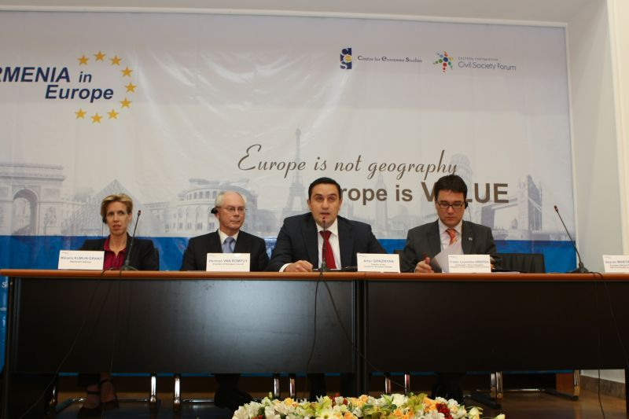

Slide 40
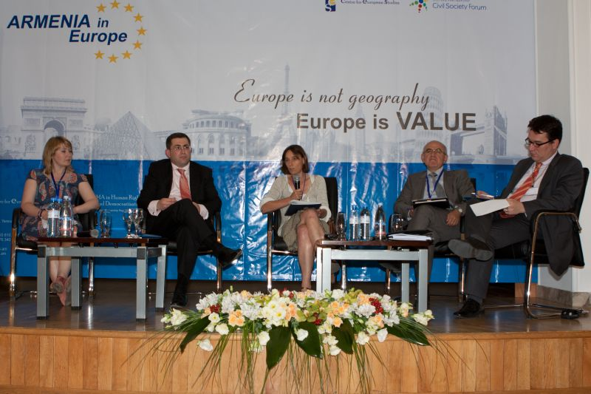
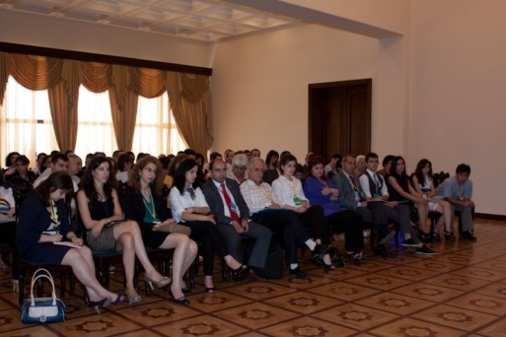
CES and YSU: "Armenia in Europe" International Conference

Slide 41
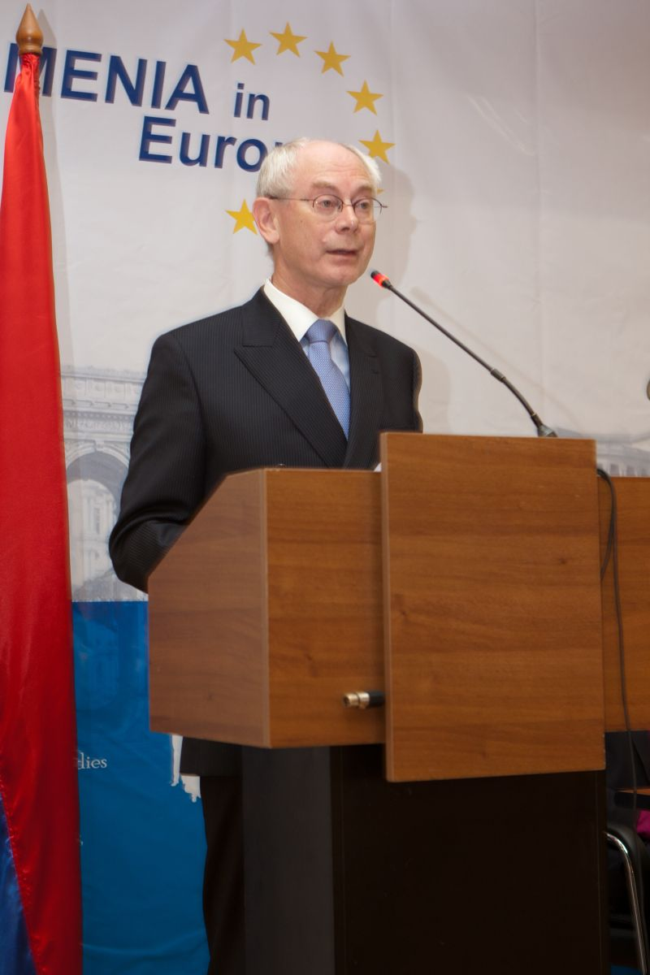
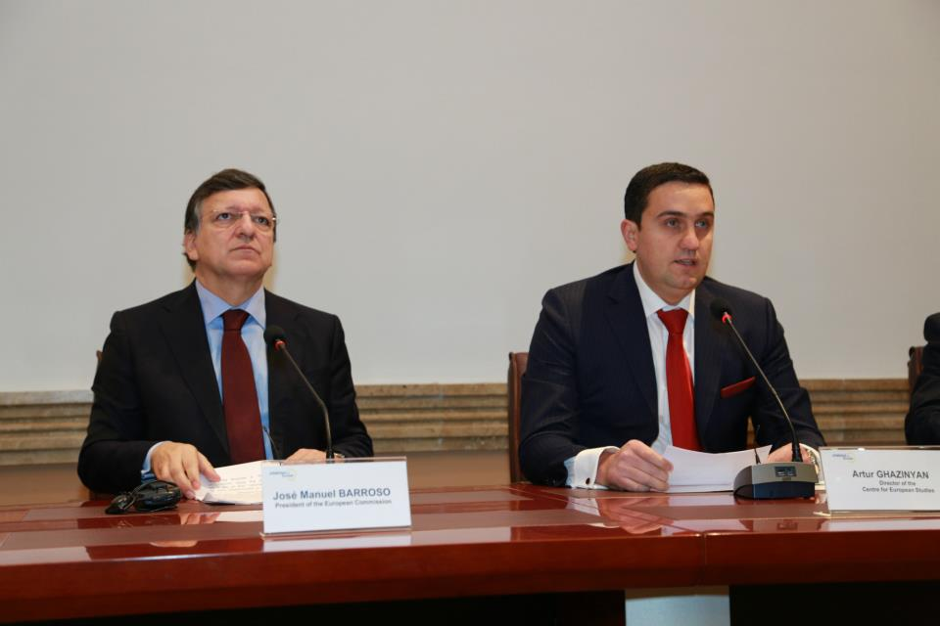
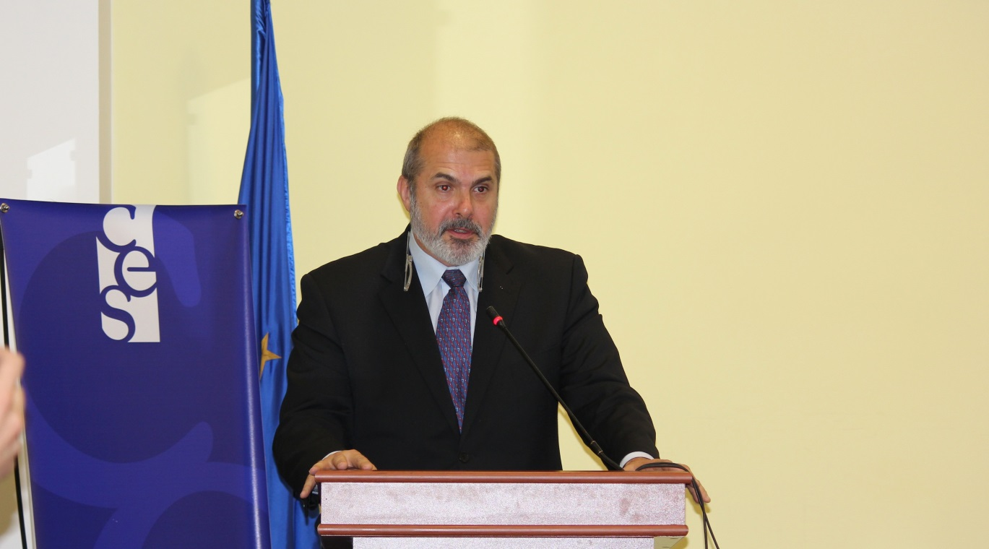
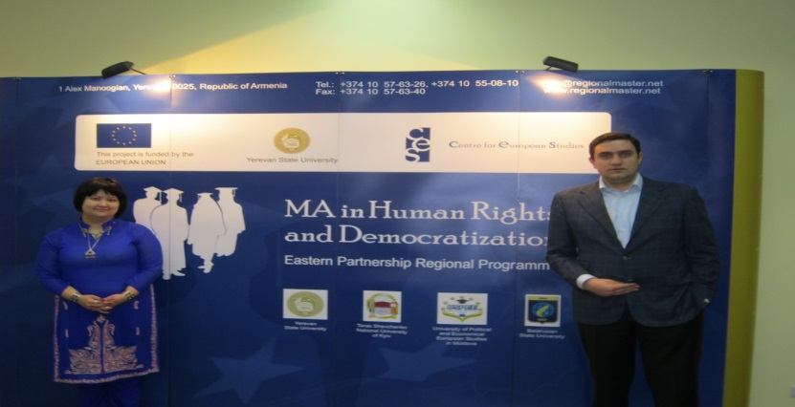

Slide 42
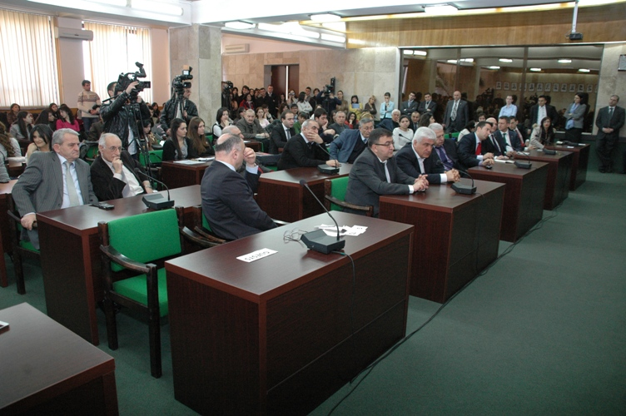
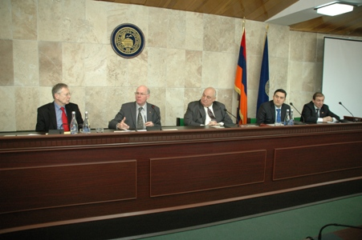
CES and YSU: President of the German Bundestag Norbert Lammert Gave a Lecture
On March 7th, 2013 the President of Bundestag of the Federal Republic of Germany prof. Dr.Norbert Lammert gave a lecture on "Europe in Times of Globalization-Cooperation and Integration“.

Slide 43
CES and YSU
On 11th of April, 2013, the presentation of the book “Armenia-EU economic relations. The impact of the Deep and Comprehensive Free trade Agreement on the bilateral trade relations” was held at the Centre for European Studies.
Conference on Educational system in Armenia
On April 4, 2013 Armenia in Europe Pan-Armenian youth student national movement and Armenian national Student Association organized a conference on educational quality in Armenia at the Centre for European Studies.

Slide 44
CES and YSU: Meeting with the Armenian National Platform of EaP Civil Society Forum
On 19th of December, 2012 meeting of the students of EaP Regional Master’s Programme in Human Rights and Democracy and European Studies with the Armenian National Platform of the EaP Civil Society Forum took place. The speakers were Boris Navasardyan (director of Yerevan Press Club) and Stepan Grigoryan (director of the Analytical Centre on Globalization and Regional Cooperation ). The opening speech was by the director of the Centre for European Studies Artur Ghazinyan. The meeting was on the role of civil society and on Eastern Partnership Civil Society Forum.

Slide 45
CES and YSU
The presentation of the book “World Economy Today: Main intentions and developments” took place on September 19, 2012 at Robert Shuman Hall and was jointly organized by the Centre for European Studies, Yerevan State University and the Alternative Center for Education, Policy Research and Economic Analyses.
INAUGURATION LESSON FOR NEW STUDENTS
The official inauguration for the new twenty-nine students of the Regional Mater’s Programme on Human Rights and Democratization was held on September 13, 2012 in the Hall of Sessions of YSU Academic Council.
On 1 June 2012the EU Special Representative for the South Caucasus, Ambassador Philippe Lefort visited the Center for European Studies of the Yerevan State University to meet with the teaching staff, experts and students of the Centre for European.

Slide 46
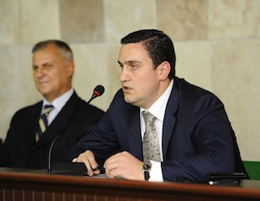
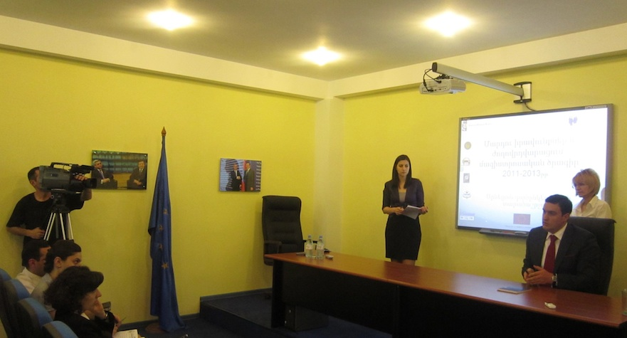
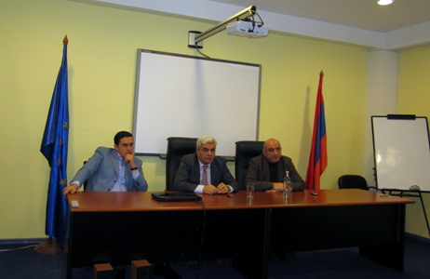
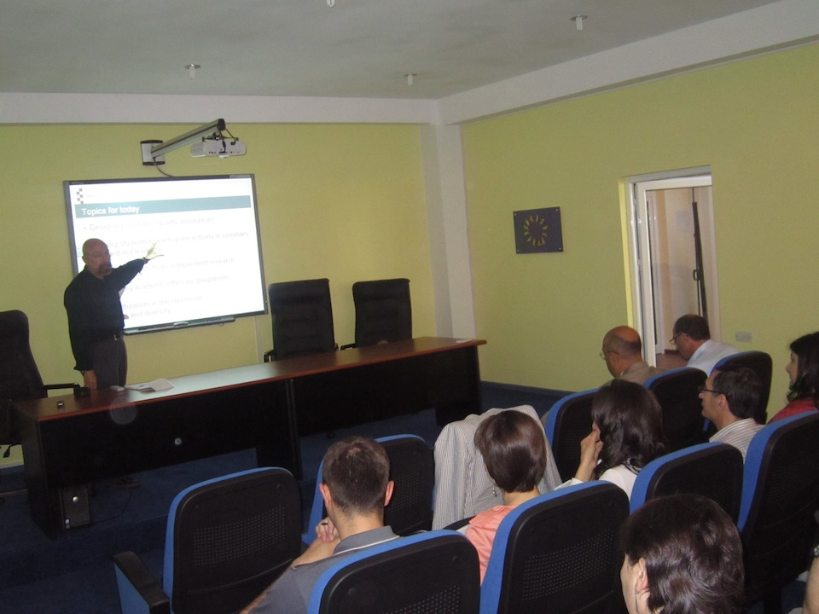
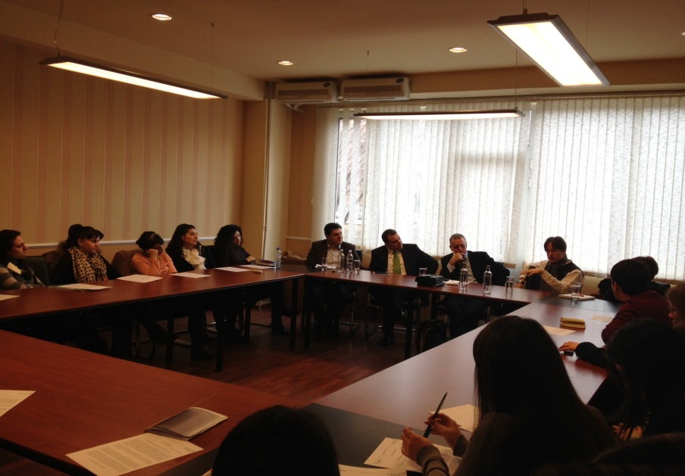

Slide 47
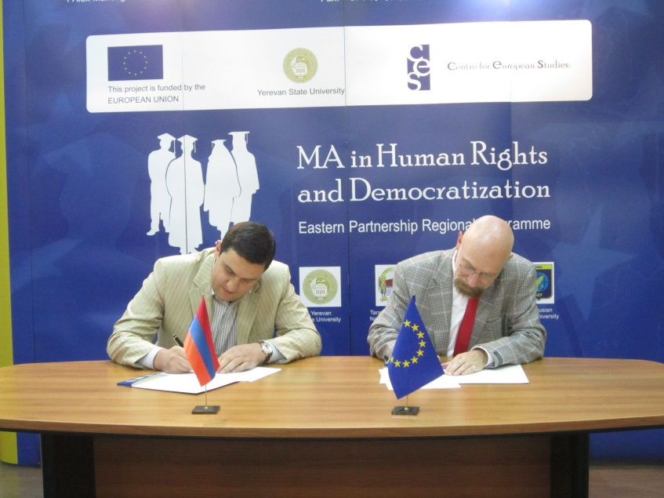
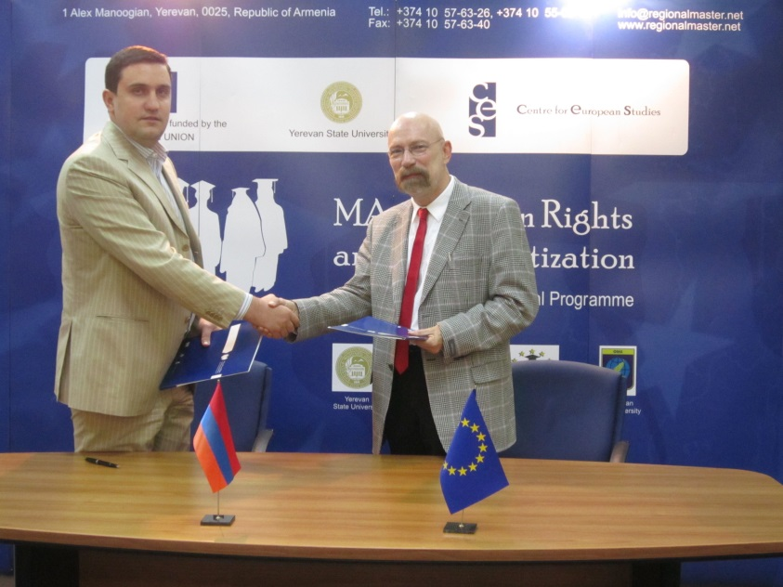
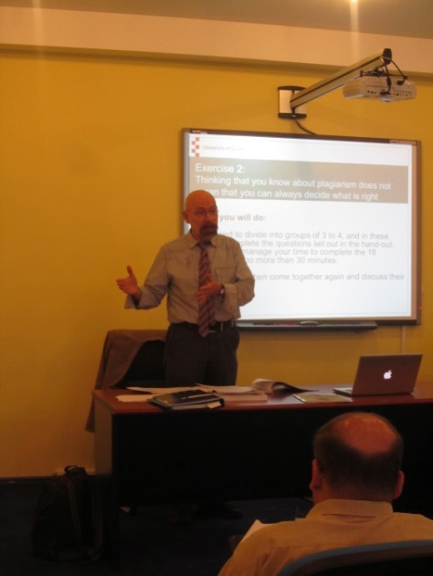
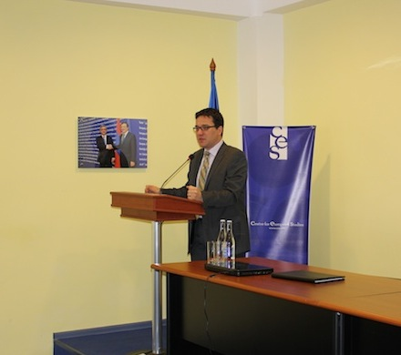
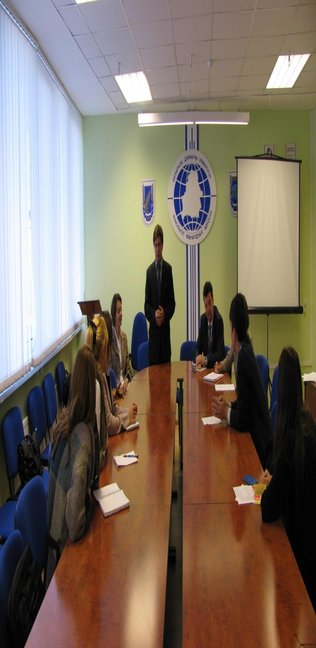
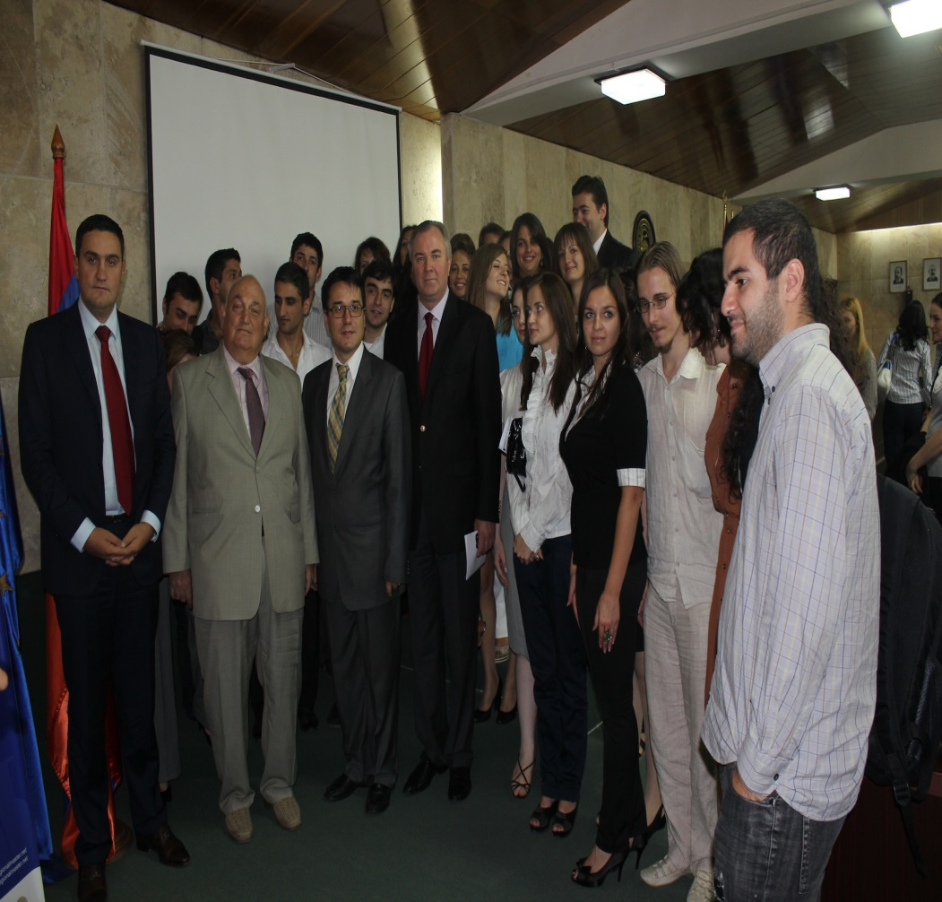

Slide 48
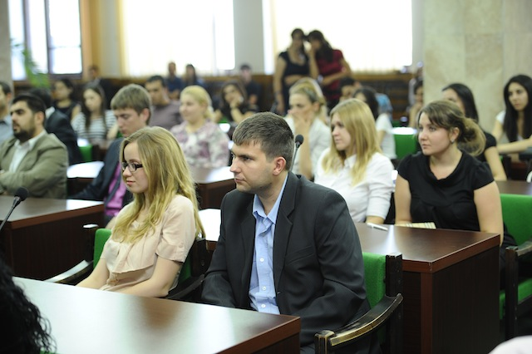
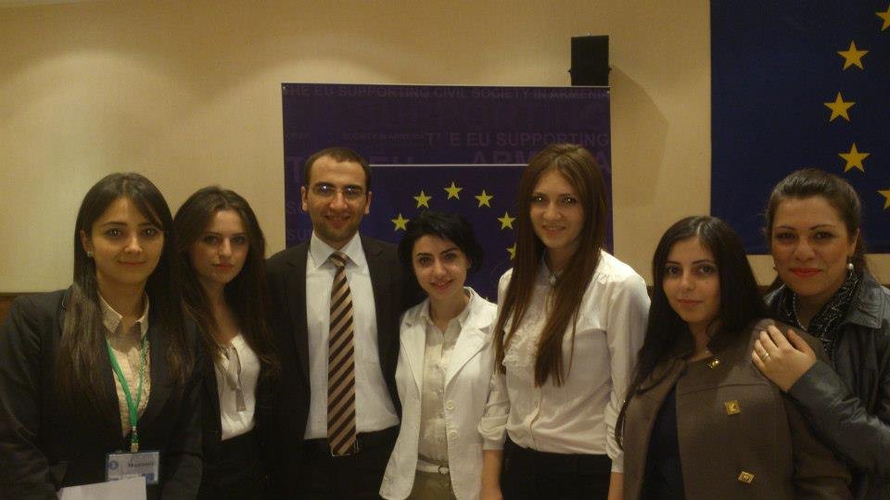
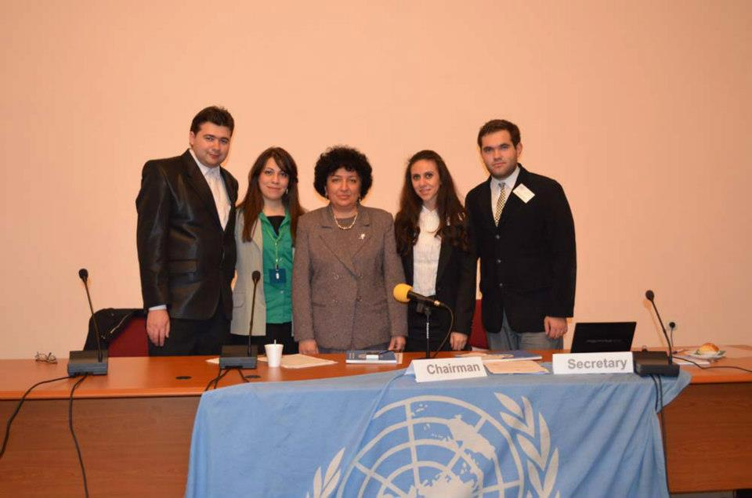
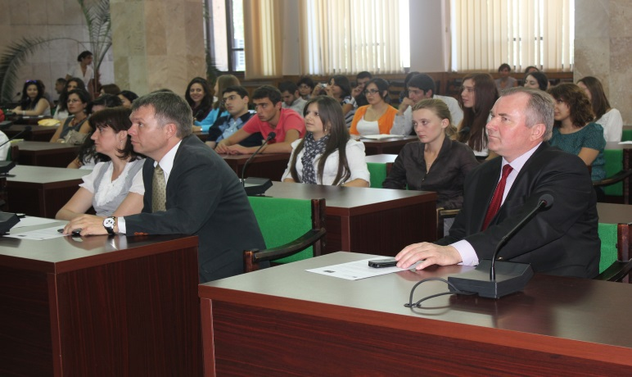
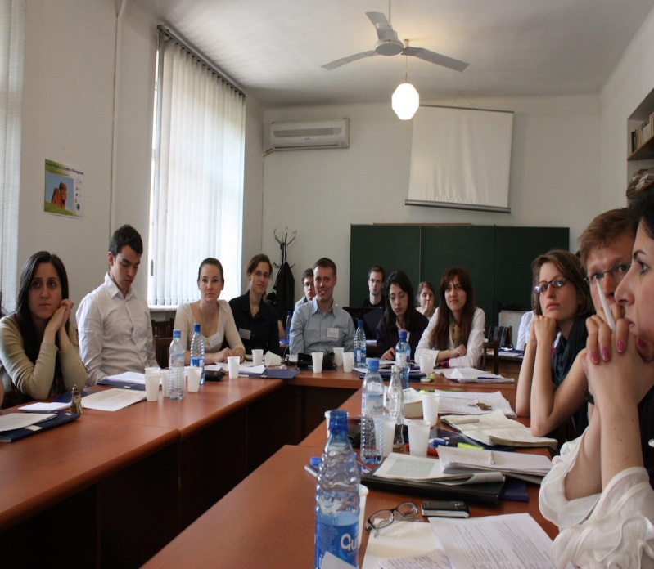
CES Students

Slide 49
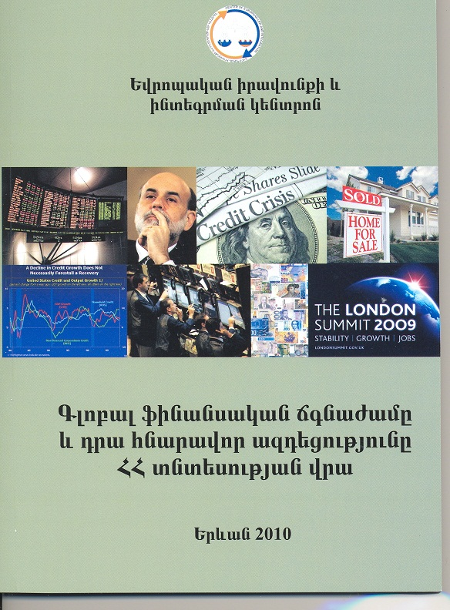
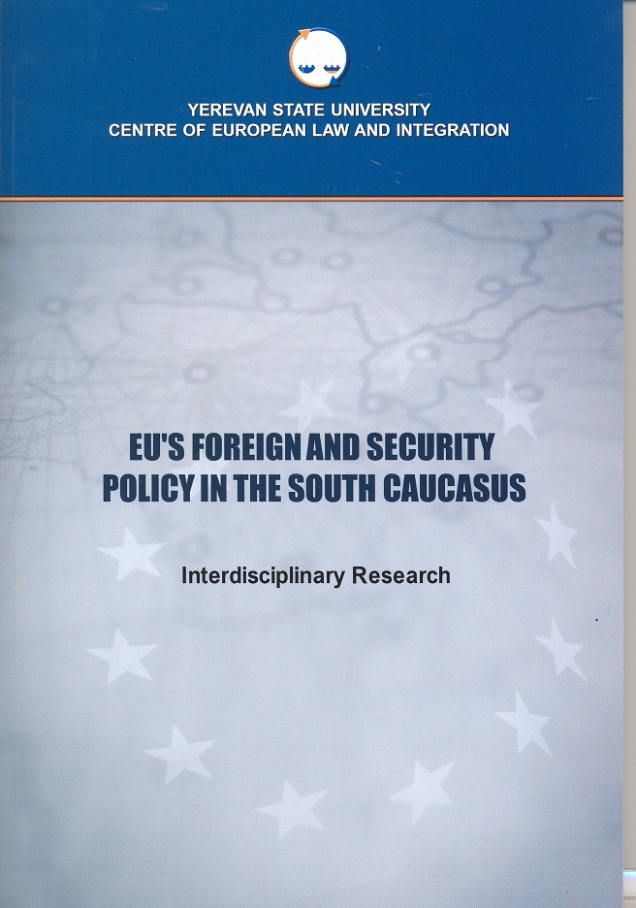
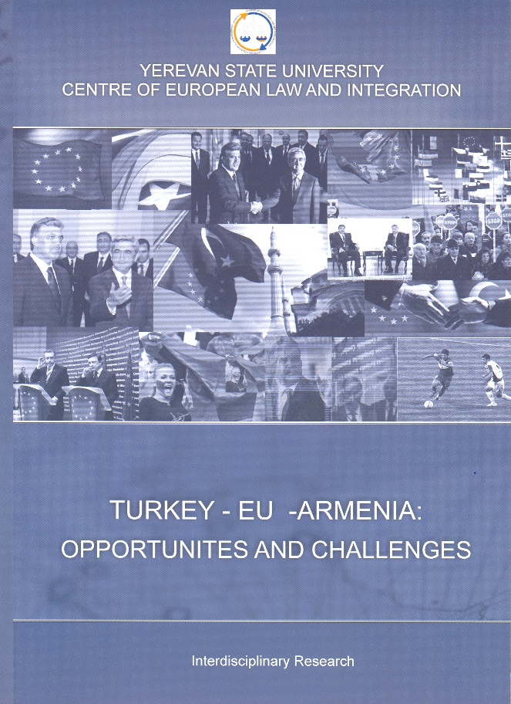
CES publications
"Global financial crisis and its influence on Armenia’s economy" (in Armenian)
"EU’s foreign and security policy in South Caucasus" Interdisciplinary study (in English and in Armenian)
“Turkey-EU-South Caucasus. opportunities and challenges” Interdisciplinary study (in English and in Armenian)

Slide 50
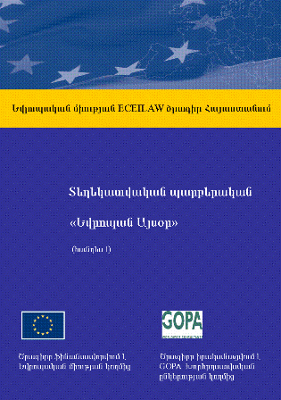
CES publications
"Attitude of Yerevan citizens towards the process of European integration", Analysis of the sociological survey results
Comparative study of Armenian and European educational systems titled "Integration of European higher education system and participation of Armenia in this process“
Armenia’s economy from the point of Copenhagen economic criteria (in Armenian)
Treaties establishing the European Union and European Community (in Armenian)
"Europe Today" information brochure

Slide 51
Thanks!
Dr. Ashot Aleksanyan
Associate Professor, Doctor of Politics,
Center of European Studies, Yerevan State University
1 Alex Manoogian, 0025, Yerevan, Armenia
E-mail: ashalex@ysu.am
http://www.ces.am
http://www.regionalmaster.net

